Slide 1
Brain Tumor Segmentation and Classification Using Image Processing
Md. Rakibul Islam Shanto
ID : 203-15-3871
And
Samsun Naher Asme
ID : 203-15-3882
Department of CSE
Daffodil International University
Narayan Ranjan Chakraborty
Associate Head & Associate Professor
Department Of CSE
Daffodil International University

Slide 2
Outline
Introduction
Problem Statement
Motivation and Objective
Related Works
Comparison Between Existing Works
Gap Analysis
Proposed Methodology
Q & A

Slide 3
Introduction
Brain tumor segmentation
Tumour classification
Early detection for early diagnosis.

Slide 4
Problem Statement
Data collection
Time consuming and costly
Tumor detection and accuracy
Gaining trust and support from professionals and patients.

Slide 5
Motivation and Objective
Motivation
Defend the mistakes of diagnosis
Save time and life
Helping early detection and early diagnosis
Objectives
Satisfy the patient
Giving professionals a friend
User friendly website

Slide 6
Related Works
Paper number [10], [11], [16] etc
Pre Processing – Labelling, Image extraction, RGB
Segmentation – Median filter, absolute automatic method, SOP
Classification – KNN, SVM, Custom CNN

Slide 7
Comparison Between Existing Works
Sl no | Author | Algorithms | Result
01 | Sravanthi, N.S.R.D.N. at el [2] | SVM, SOM | 97%
02 | Jalali, V. at el [7] | DNN, CNN, RNN, KNN, SVM, PatterNet | PatternNet = 98.9%
03 | Periasamy, J.K. at el [22] | CNN, ResNet18, GoogleLeNet, CapsNet architecture | ResNet18 = 89.46%

Slide 8
Gap Analysis
RFC (Random Forest Classifier) missing in some papers
Lack of using either segmentation or classification only
Using novel feature extraction instead of traditional life HOG.
Effect of Data augmentation

Slide 9
Proposed Methodology
Cropping,
Grayscale Conversion,
Image Blurring,
Skull Detection
Pre-Processing
Segmentation
SOM, Fuzzy C Means, K-means,
LE
Classification
Custom CNN,
Transfer Learning with CNN, Modal Evaluation

Slide 10
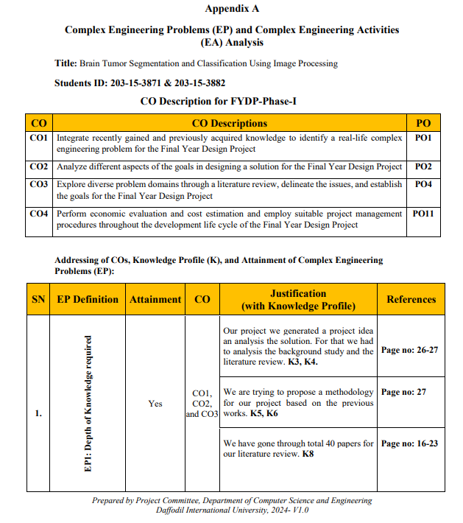
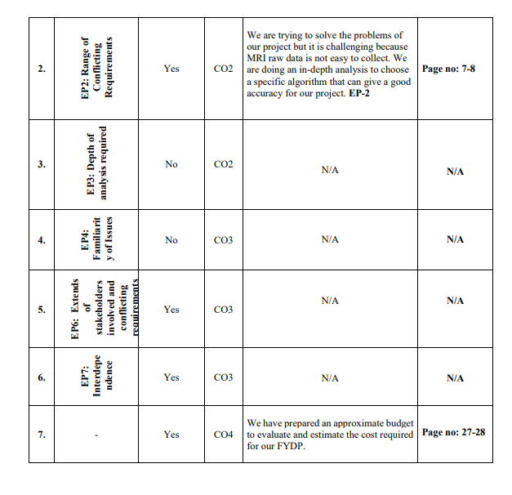
Appendix

Slide 11
THANK YOU

